Slide 1
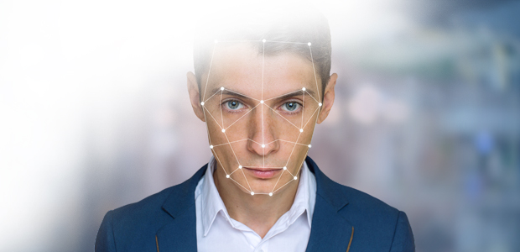
Automated Attendance System – By A.i.
In a Contribution with –
Aayush Shah
Dakshesh Shah
Jay Thakkar

Slide 2


Why to Automate ?
To make the attendance faster without
human intervention.
No need to mark a presence of an employee
by himself and there is no need to dedicate a
person to take attendance.

Slide 3





Some Good Solutions
1. Scanning ID cards
2. Using Scanners
3. Using Face Recognition

Slide 4

Where…
Scanning ID Card with RFID Scanner becomes :
Costly
Maintenance (Need to provide individual cards with built in chip )
Fingerprint Scanner is :
Costlier Than anything ( With the System Installed )

Slide 5







But With Face Recognition...
It is Affordable
One-Time Small Investment (OTSI )
Easy to use ( Just Show your face ! )

Slide 6
How it generally works ?
Step 1
Create faces’ dataset and train ( One time train only )
Step 2
Detect the face and pass in the Neural Network
To recognize the person
Step 3
If the person is recognized, then mark his/her presence
In the database ( Attendance )

Slide 8

How it Works ?
Images
Database

